Slide 1


WILDFIRE MANAGER
MUSA 508 Public Policy
Hui Tian & Jiali Yao

Slide 2

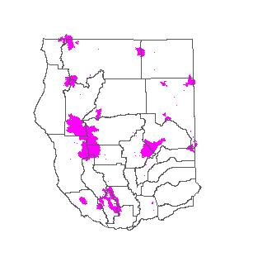
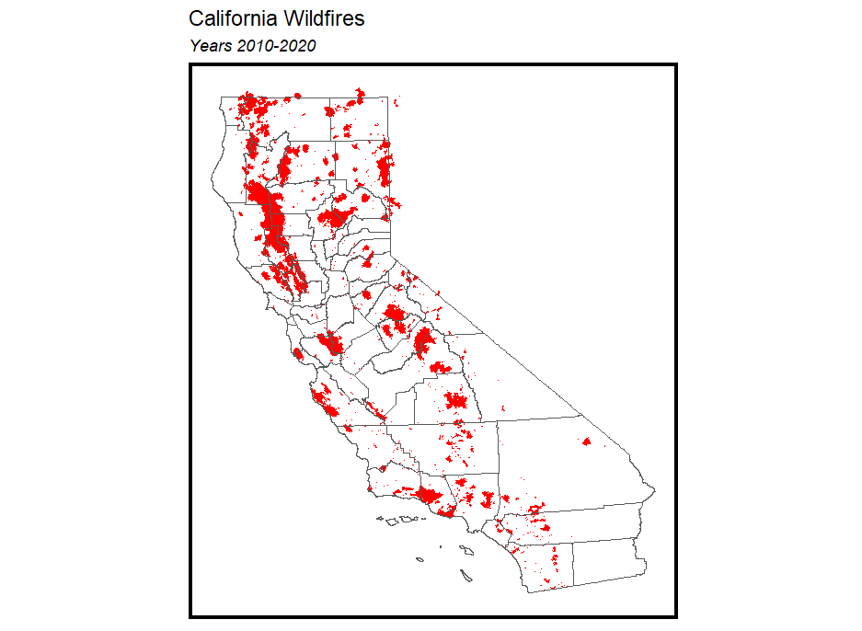
Strategy - Business Objective
Northern California Wildfires in 2020
Wildfires result in huge economic & environmental loss (eg. 9,917 wildfire incidents, burned 4,257,863 acres, caused 33 fatalities in California in 2020)
Target wildfires occurred in Northern California regions in 2020
Build prediction model
Reduce wildfire risk
Make funding allocation effectively

Slide 3
Strategy - User Analysis
We target on California Department of Forestry and Fire Protection (CAL FIRE) as key users.
Current Fire Prevention Projects
Brush clearance
Prescribed fire
Defensible space inspections
Functions to meet in APP design
Predict high fire risk zones
Create fire hazard map
Estimate cost & benefit
Emergency evacuation planning
Fire hazard severity mapping
Apply for prevention funding
Report potential risk on patrol
Fire-related law enforcement

Slide 4

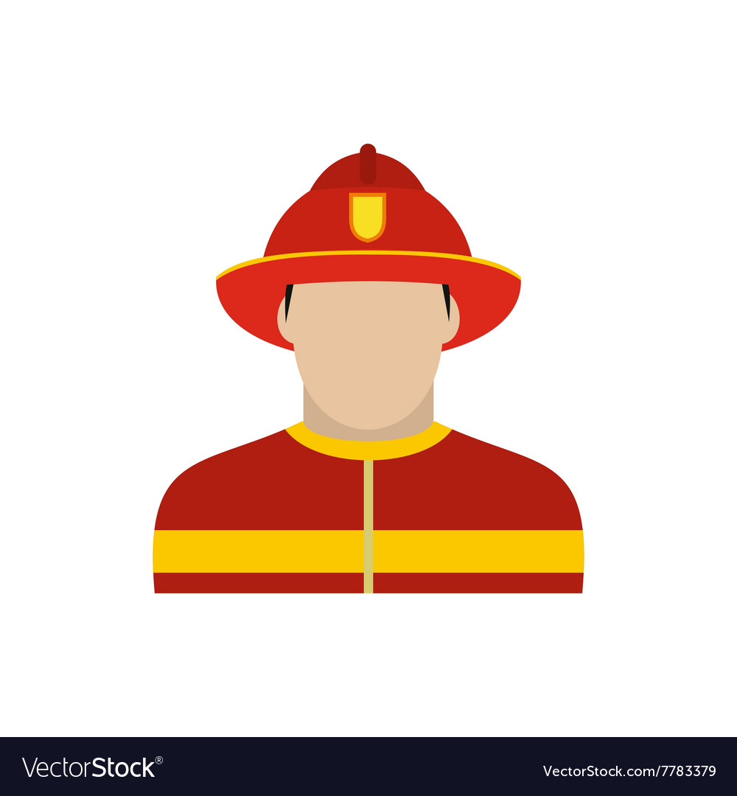
Strategy - User Persona
Aaron Bruce
Job : Officer in Fire Department
Age: 42
Work Scope:
Make burn plans for high wildfire risk zones
Create Fire hazard severity mapping
Prepare report to apply for funding
Expectations:
Decide high priority zone for prevention
Make hazard mapping easier
Make funding allocation effectively
Tom Smith
Job : Firefighter
Age: 25
Work Scope:
Suppress fire accidents
Burn Control high wildfire risk zones
Inspect patrol zone
Expectations:
Burn Control effectively
Report inspected risk easier

Slide 5
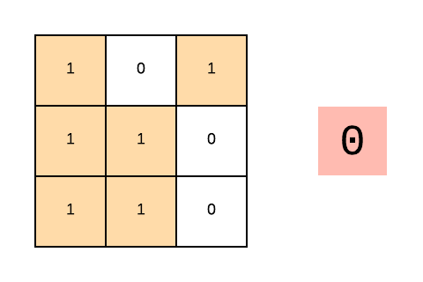
Traditional Approach
Data-driven Approach
Made burn plans in terms of experience
Wind,
Humidity,
Temperature,
Moisture of the vegetation,
Conditions for the dispersal of smoke,
Conditions on the ground.
Inefficient Allocation of Resources
Prioritise to the places at higher risk
Highest‑priority and most cost‑effective programs receive funding

Slide 6

Research - Data Overview
Weather
Land Cover
Terrain
Power
Wind Direction
Wind Speed
Temperature
Precipitation
Humidity
Forest
Woodland
Shrub
Herbaceous
Wetland
Water
Elevation
Slope
Aspect
Electric substation
Electric Transmission Line
WORKFLOW
Feature Engineering
Machine
Learning
Results
Analyze Cost & Benefits
Fire Data & Factors
GIS & R
Processing
Logistic Regression

Slide 7
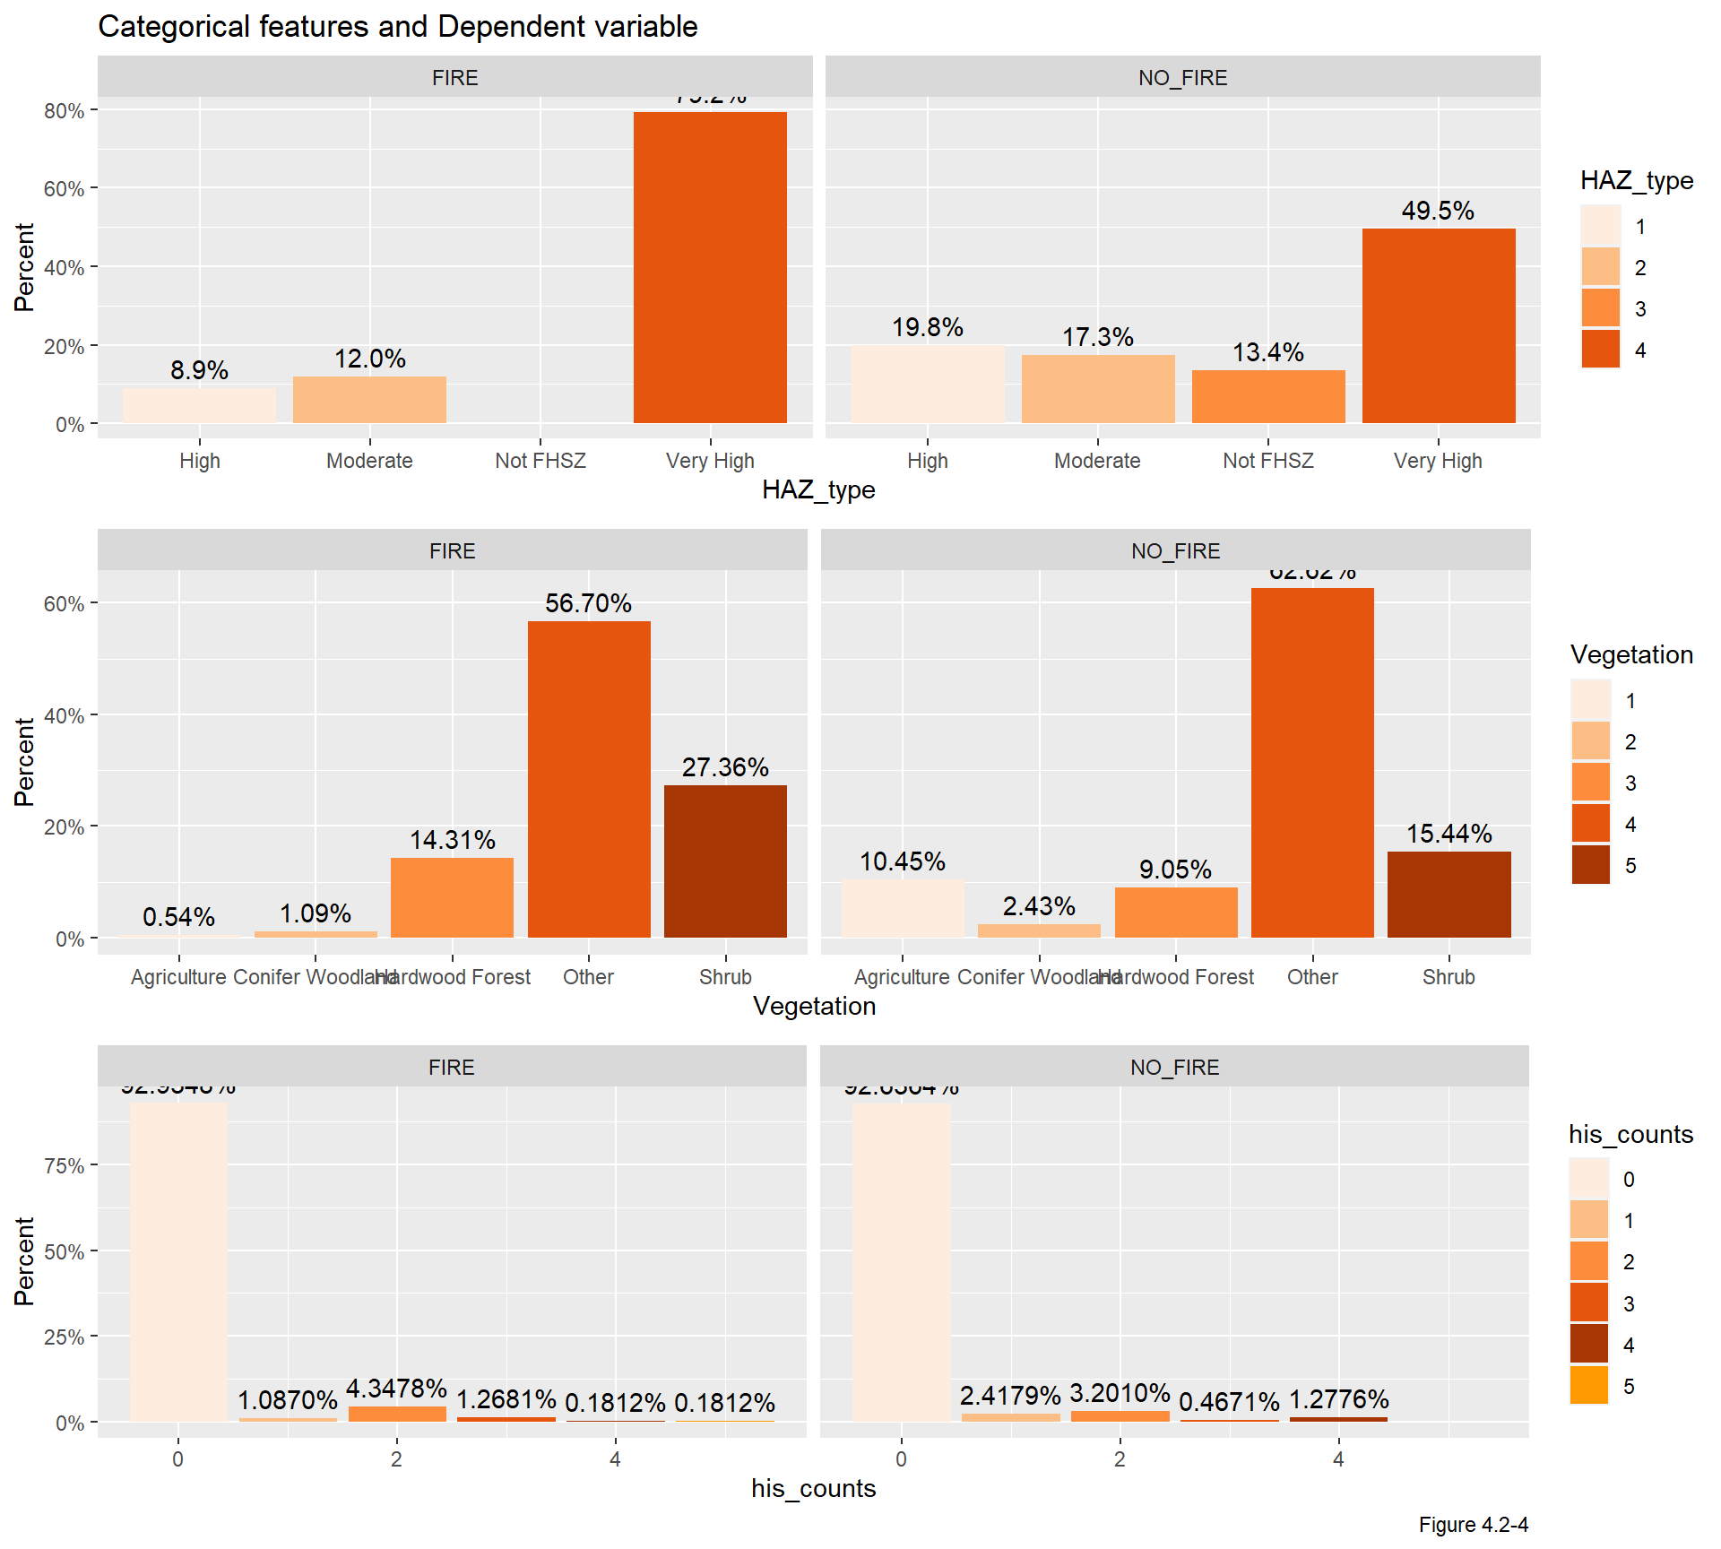
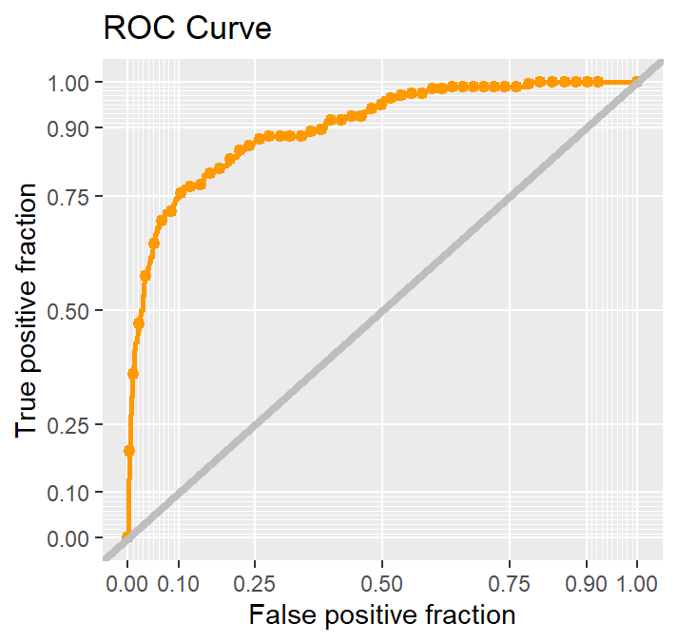
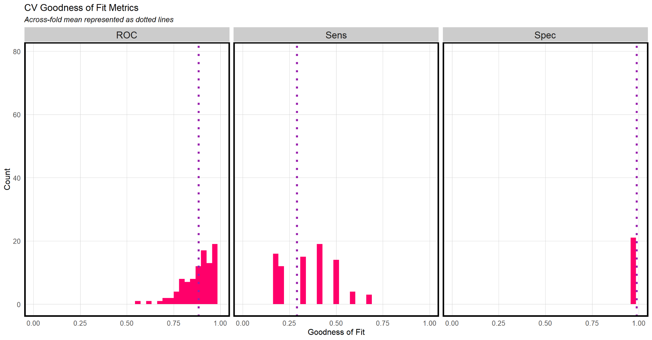
Research -Validate Model
Receiver Operating Characteristic Curve (ROC)
Feature associations w/ likelihood of wildfire
CV Goodness of Fit Metrics

Slide 8
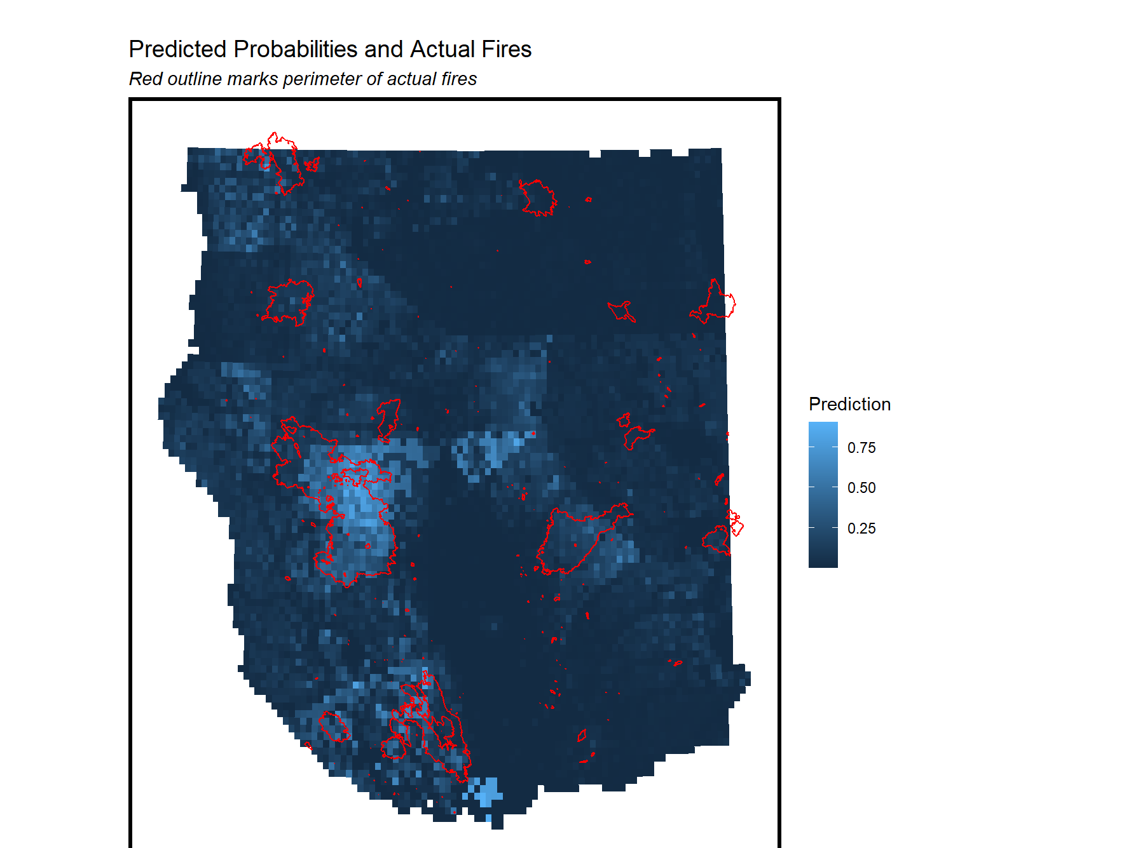
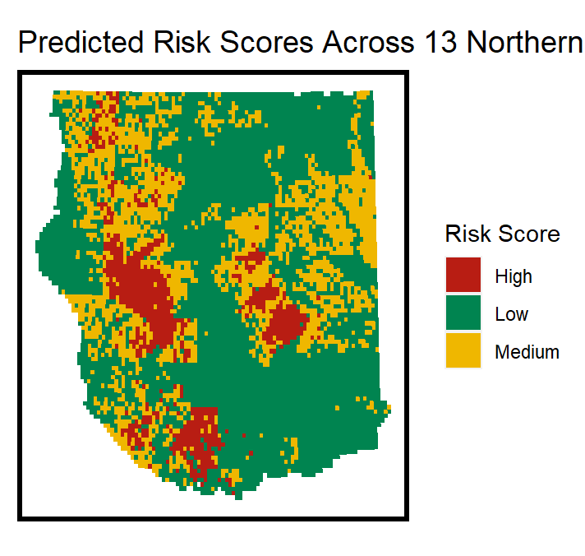
Research - Prediction Results
Predicted Risk Scores in Northern California

Slide 9
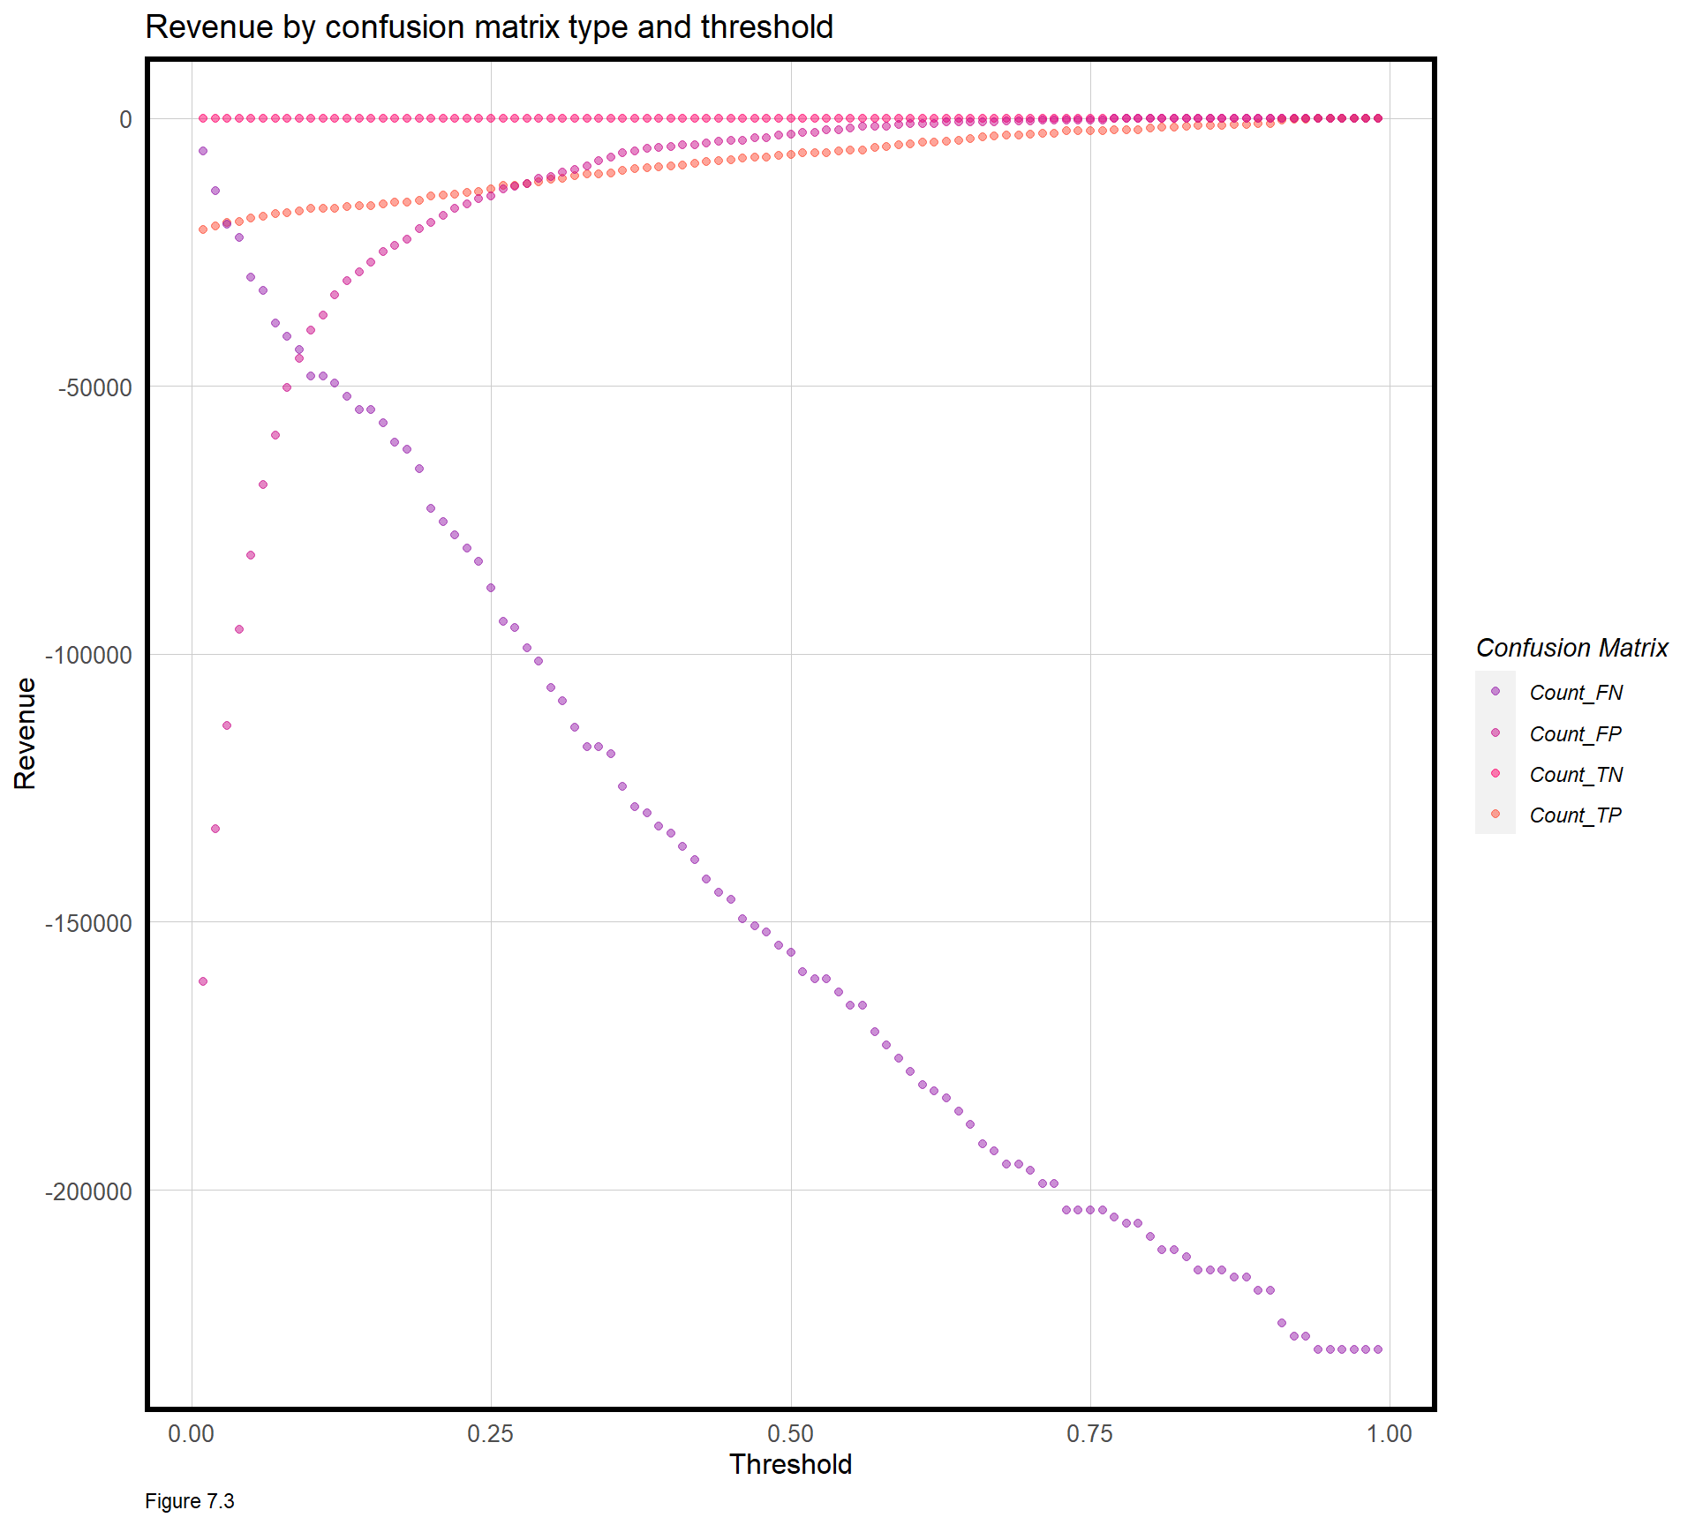
Research - Cost & Benefit Analysis
True Positive - Predicted correctly at high fire risk areas
& allocated prevention funding. [Prescribe cost $200/acre]
True Negative - Predicted correctly at low fire risk areas,
no prevention were allocated. [$0]
False Positive - Predicted incorrectly at low fire risk
areas, allocated prevention. [Prescribe cost $200/acre]
False Negative - Predicted incorrectly at high fire risk
areas, no prevention allocated, and fire caused damage.
[Suppress cost $ 800/acre + Damage cost $1345/acre(1)]
0.1 as the optimal threshold to minimize the damage cost & use funding effectively
Economic footprint of California wildfires in 2018 | Nature Sustainability
Notes:
Finally, we will do the cost & benefit analysis
In our case,
Even when we get true positive, we still anticipate a small possibility that there would be fire;
Because From the department’s points of view. Our target value would be cost instead of revenue, considering wildfire management is the government’s responsibility to spend money and time to protect citizens’ safety and the nature we are living in.

Slide 10
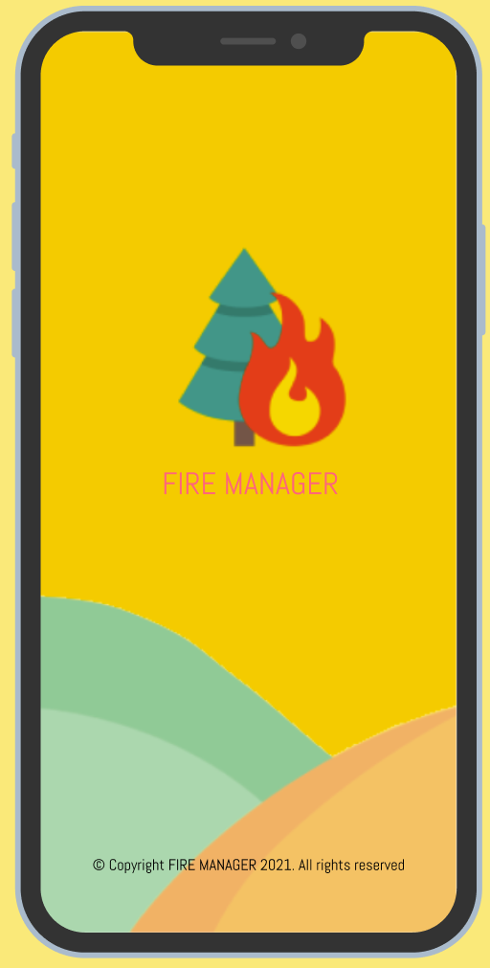
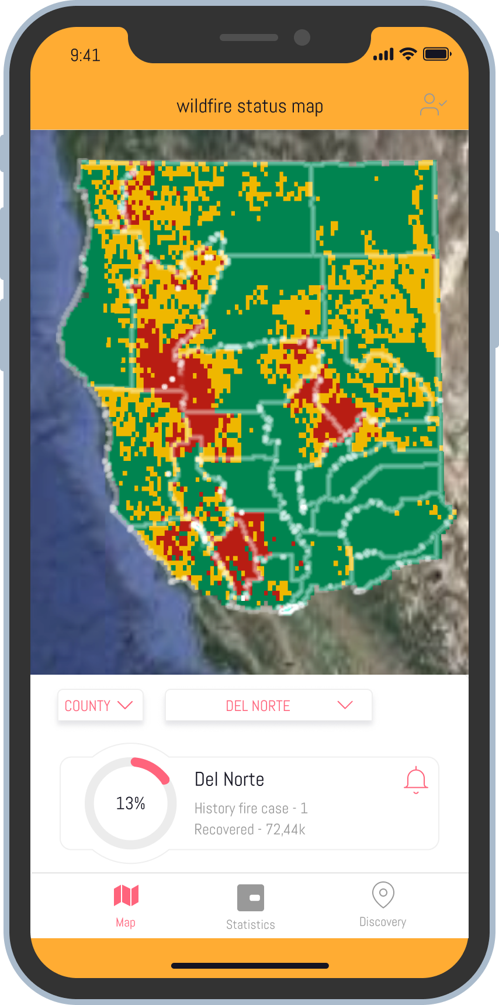
Design - APP Wireframe
Predict high fire risk zones
Notes:
The first window of our app will be the risk level map, users can select a specific country or city form the drop down, the widow on the right shows how the department officers can use our app to enter the potential funds to look for how many percent can these amount of extra fund can lower the wildfire risk.

Slide 11
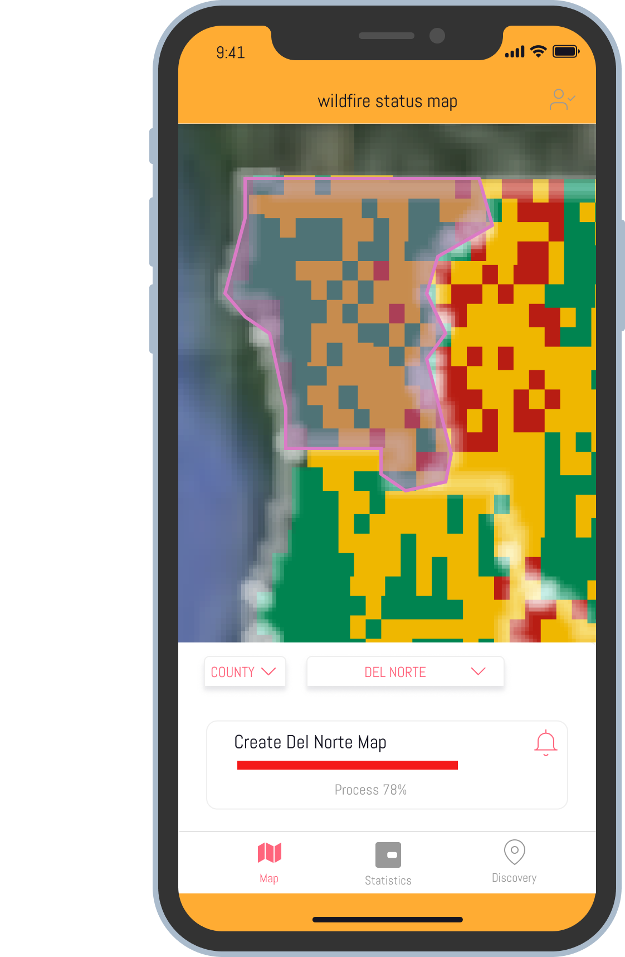
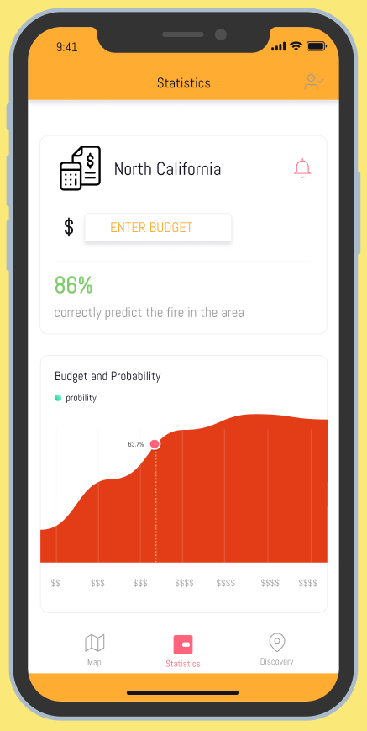
Design - APP Wireframe
Create fire hazard map
Estimate cost & benefit

Slide 12
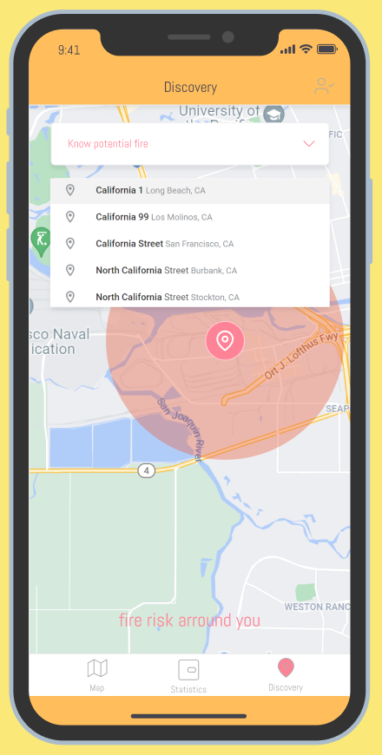
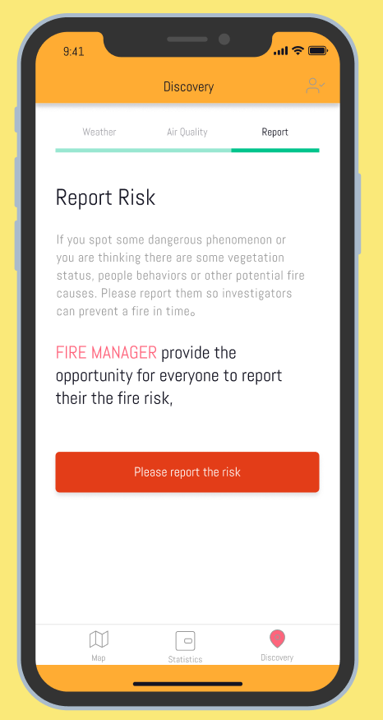
Design - APP Wireframe
Report potential risk on patrol
Notes:
When we focus more on our residents side, our app allows them to locate where they are or search for the their interested spots to see the fire risk of certain radius, as well as the current weather (wind, humidity, temperature…) and air quality.
Also we encourage people to report potential risk timely so the investigators can come check and prevent the fire.

Slide 13
THANK YOU
For more information, you can visit the link below
https://github.com/Hui-Tian/Wildfire_Manager

